Slide 1
Smoothing and Log-Linear Language Models
CS 162: Natural Language Processing
Nanyun (Violet) Peng
Course website: https://vnpeng.net/cs162_win24.html
syllabus,
announcements,
slides,
homeworks
Adapted from Jason Eisner’s course
1

Slide 2
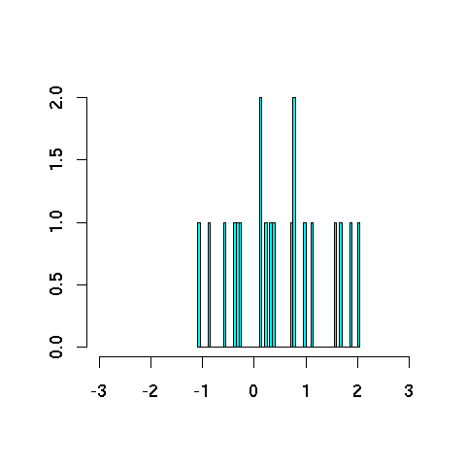
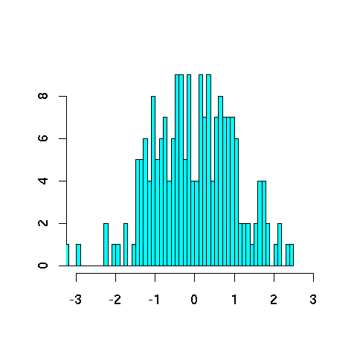
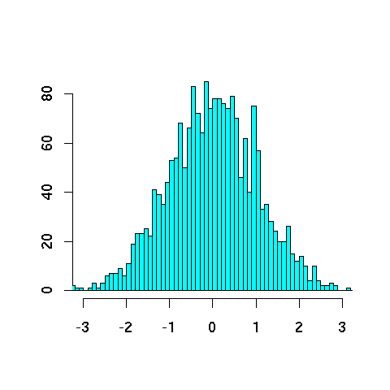
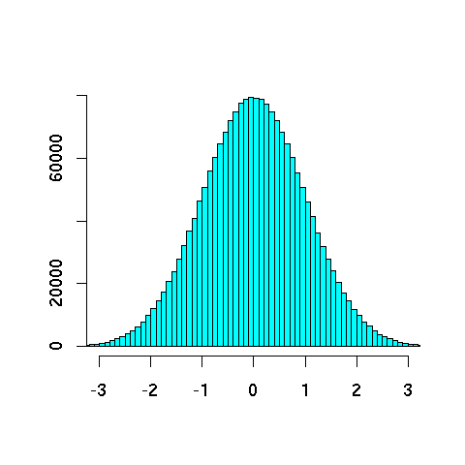
Never trust a sample under 30
20
200
2000
2000000
Notes:
Statistics 101
Sampling from a gaussian

Slide 3
Never trust a sample under 30
Smooth out the bumpy histograms to look more like the truth
(we hope!)

Slide 4
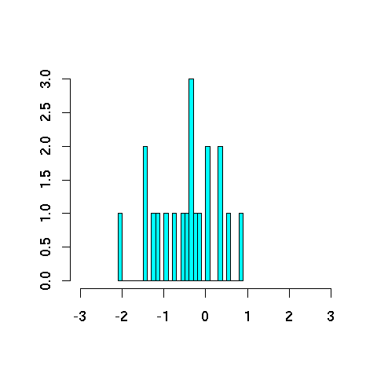
Smoothing reduces variance
But adding bias!!
truth
truth
bias
average
unsmoothed estimates from different samples
estimates are correct on average: such an estimation method is called unbiased
estimates are typically far from truth (high variance (mean squared error))
smoothed estimates from different samples
estimates are incorrect on average: such an estimation method is called biased
but estimates are typically close to average (low variance (mean squared distance))
and so may tend to be closer to truth, too

Slide 5
How to Estimate Parameters?
p(z | xy) = ?
Suppose our training data includes … xya .. … xyd … … xyd … but never xyz
Should we conclude p(a | xy) = 1/3? p(d | xy) = 2/3? p(z | xy) = 0/3?
NO! Absence of xyz might just be bad luck.

Slide 6
Smoothing the Estimates
Should we conclude no! p(a | xy) = 1/3? reduce this p(d | xy) = 2/3? reduce this p(z | xy) = 0/3? increase this
Discount the positive counts somewhat
Reallocate that probability to the zeroes

Slide 7
Add-One Smoothing
xya | 1 | 1/3 | 2 | 2/29
xyb | 0 | 0/3 | 1 | 1/29
xyc | 0 | 0/3 | 1 | 1/29
xyd | 2 | 2/3 | 3 | 3/29
xye | 0 | 0/3 | 1 | 1/29
…
xyz | 0 | 0/3 | 1 | 1/29
Total xy | 3 | 3/3 | 29 | 29/29

Slide 8
Add-One Smoothing
300 observations instead of 3 – better data, less smoothing
xya | 100 | 100/300 | 101 | 101/326
xyb | 0 | 0/300 | 1 | 1/326
xyc | 0 | 0/300 | 1 | 1/326
xyd | 200 | 200/300 | 201 | 201/326
xye | 0 | 0/300 | 1 | 1/326
…
xyz | 0 | 0/300 | 1 | 1/326
Total xy | 300 | 300/300 | 326 | 326/326

Slide 9
Problem with Add-One Smoothing
We’ve been considering just 26 letter types …
xya | 1 | 1/3 | 2 | 2/29
xyb | 0 | 0/3 | 1 | 1/29
xyc | 0 | 0/3 | 1 | 1/29
xyd | 2 | 2/3 | 3 | 3/29
xye | 0 | 0/3 | 1 | 1/29
…
xyz | 0 | 0/3 | 1 | 1/29
Total xy | 3 | 3/3 | 29 | 29/29

Slide 10
Problem with Add-One Smoothing
Suppose we’re considering 20000 word types, not 26 letters
see the abacus | 1 | 1/3 | 2 | 2/20003
see the abbot | 0 | 0/3 | 1 | 1/20003
see the abduct | 0 | 0/3 | 1 | 1/20003
see the above | 2 | 2/3 | 3 | 3/20003
see the Abram | 0 | 0/3 | 1 | 1/20003
…
see the zygote | 0 | 0/3 | 1 | 1/20003
Total | 3 | 3/3 | 20003 | 20003/20003

Slide 11
Problem with Add-One Smoothing
Suppose we’re considering 20000 word types, not 26 letters
see the abacus | 1 | 1/3 | 2 | 2/20003
see the abbot | 0 | 0/3 | 1 | 1/20003
see the abduct | 0 | 0/3 | 1 | 1/20003
see the above | 2 | 2/3 | 3 | 3/20003
see the Abram | 0 | 0/3 | 1 | 1/20003
…
see the zygote | 0 | 0/3 | 1 | 1/20003
Total | 3 | 3/3 | 20003 | 20003/20003
“Novel event” = 0-count event (never happened in training data).
Here: 19998 novel events, with total estimated probability 19998/20003.
So add-one smoothing thinks we are extremely likely to see novel events, rather than words we’ve seen in training data.
It thinks this only because we have a big dictionary: 20000 possible events.
Is this a good reason?
11

Slide 12
Infinite Dictionary?
In fact, aren’t there infinitely many possible word types?
see the aaaaa | 1 | 1/3 | 2 | 2/(∞+3)
see the aaaab | 0 | 0/3 | 1 | 1/(∞+3)
see the aaaac | 0 | 0/3 | 1 | 1/(∞+3)
see the aaaad | 2 | 2/3 | 3 | 3/(∞+3)
see the aaaae | 0 | 0/3 | 1 | 1/(∞+3)
…
see the zzzzz | 0 | 0/3 | 1 | 1/(∞+3)
Total | 3 | 3/3 | (∞+3) | (∞+3)/(∞+3)

Slide 13
Add-Lambda Smoothing
A large dictionary makes novel events too probable.
To fix: Instead of adding 1 to all counts, add λ = 0.01?
This gives much less probability to novel events.
But how to pick best value for λ?
That is, how much should we smooth?

Slide 14
Add-0.001 Smoothing
Doesn’t smooth much (estimated distribution has high variance)
xya | 1 | 1/3 | 1.001 | 0.331
xyb | 0 | 0/3 | 0.001 | 0.0003
xyc | 0 | 0/3 | 0.001 | 0.0003
xyd | 2 | 2/3 | 2.001 | 0.661
xye | 0 | 0/3 | 0.001 | 0.0003
…
xyz | 0 | 0/3 | 0.001 | 0.0003
Total xy | 3 | 3/3 | 3.026 | 1

Slide 15
Add-1000 Smoothing
Smooths too much (estimated distribution has high bias)
xya | 1 | 1/3 | 1001 | 1/26
xyb | 0 | 0/3 | 1000 | 1/26
xyc | 0 | 0/3 | 1000 | 1/26
xyd | 2 | 2/3 | 1002 | 1/26
xye | 0 | 0/3 | 1000 | 1/26
…
xyz | 0 | 0/3 | 1000 | 1/26
Total xy | 3 | 3/3 | 26003 | 1
Notes:
The last column is simplified and is estimate number.

Slide 16
Add-Lambda Smoothing
A large dictionary makes novel events too probable.
To fix: Instead of adding 1 to all counts, add λ = 0.01?
This gives much less probability to novel events.
But how to pick best value for λ?
That is, how much should we smooth?
E.g., how much probability to “set aside” for novel events?
Depends on how likely novel events really are!
Which may depend on the type of text, size of training corpus, …
Can we figure it out from the data?

Slide 17
Setting Smoothing Parameters
How to pick best value for λ? (in add- λ smoothing)
Try many λ values & report the one that gets best results?
How to measure whether a particular λ gets good results?
Is it fair to measure that on test data (for setting λ)?
Moral: Selective reporting on test data can make a method look artificially good. So it is unethical.
Rule: Test data cannot influence system development. No peeking! Use it only to evaluate the final system(s). Report all results on it.
Training
Test

Slide 18
Setting Smoothing Parameters
How to pick best value for λ?
Try many λ values & report the one that gets best results?
How to fairly measure whether a λ gets good results?
Hold out some (say, 20% of training) as “development data” for purpose
Training
Test
Dev.
Training
Now use that λ to get smoothed counts from all 100% training data …
… and report results of that final model on test data.
Pick λ that gets best results on this 20% …
… when we collect counts from this 80% and smooth them using add-λ smoothing.
18

Slide 19
Setting Smoothing Parameters
Here we held out 20% of our training set (yellow) for development.
Would like to use > 20% yellow:
Would like to use > 80% blue:
Could we let the yellow and blue sets overlap?
☹ 20% not enough to reliably assess λ
☹ Best λ for smoothing 80%
≠ best λ for smoothing 100%
☹ Ethical, but foolish
Training
Test
Dev.
Training
Now use that λ to get smoothed counts from all 100% training data …
… and report results of that final model on test data.
Pick λ that gets best results on this 20% …
… when we collect counts from this 80% and smooth them using add-λ smoothing.
19

Slide 20
5-fold Cross-Validation (“Jackknifing”)
☹ 20% not enough to reliably assess λ
☹ Best λ for smoothing 80%
≠ best λ for smoothing 100%
Would like to use > 20% yellow:
Would like to use > 80% blue:
Old version: Train on 80%, test on 20%
If 20% yellow too little: try 5 training/dev splits as below
Pick λ that gets best average performance
☺ Tests on all 100% as yellow, so we can more reliably assess λ
☹ Still picks a λ that’s good at smoothing the 80% size, not 100%.
But now we can grow that 80% without trouble …
Dev.
Training
Dev.
Dev.
Dev.
Dev.
Test
Dev.
20

Slide 21
N-fold Cross-Validation (“Leave One Out”)
(more extreme version of strategy from last slide)
…
Test
To evaluate a particular λ during dev, test on all the training data: test each sentence with smoothed model from other N-1 sentences
☺ Still tests on all 100% as yellow, so we can reliably assess λ
☺ Trains on nearly 100% blue data ((N-1)/N) to measure whether λ is good for smoothing that much data: nearly matches true test conditions
☺ Surprisingly fast: why?
Usually easy to retrain on blue by adding/subtracting 1 sentence’s counts
21

Slide 22
More Smoothing Techniques
Estimate p(z | xy) of a novel token z using just the tokens we’ve seen in context xy.
Might be a small set …
Good-Turing smoothing: If many of those tokens came from singleton types , then novel types are likely in future.
P₀ = (N₁/N) / N₀ ; P₁ = (2*N₂/N) / N₁
Very nice idea (but a bit tricky in practice). See the paper “Good-Turing smoothing without tears”

Slide 23
Backoff Smoothing

Slide 24
Use the backoff
Why are we treating all novel events as the same?
p(zygote | see the) vs. p(baby | see the)
Unsmoothed probs: count(see the zygote) / count(see the)
Add-one smoothed probs: (count(see the zygote) + 1) / (count(see the) + V)
What if count(see the zygote) = count(see the baby) = 0?
baby beats zygote as a unigram
the baby beats the zygote as a bigram
∴ see the baby beats see the zygote ? (even if both have the same count, such as 0)
Backoff introduces bias, as usual:
Lower-order probabilities (unigram, bigram) aren’t quite what we want
But we do have enough data to estimate them & they’re better than nothing.
24

Slide 25
Early idea: Model averaging
Jelinek-Mercer smoothing (“deleted interpolation”):
Use a weighted average of backed-off naïve models: p_{average}(z | xy) = μ₃ p(z | xy) + μ₂ p(z | y) + μ₁ p(z) where μ₃ + μ₂ + μ₁ = 1 and all are ≥ 0
The weights μ can depend on the context xy
If we have “enough data” in context xy, can make μ₃ large. E.g.: If count(xy) is high
Learn the weights on held-out data w/ bucketing
Different μ₃ when xy is observed 1 time, 2 times, 3-5 times, …
25

Slide 26
Smoothing + backoff
Basic smoothing (e.g., add-λ, Good-Turing):
Holds out some probability mass for novel events
E.g., Good-Turing gives them total mass of N₁/N
Divided up evenly among the novel events
Backoff smoothing
Holds out same amount of probability mass for novel events
But divide up unevenly in proportion to backoff prob.
When defining p(z | xy), the backoff prob for novel z is p(z | y)
When defining p(z | y), the backoff prob for novel z is p(z)
26

Slide 27
Smoothing + backoff
Backoff smoothing (cont)
When defining p(z), do we need a backoff prob for novel z?
What could the backoff prob be?
There are several famous backoff smoothing algorithms:
modified Kneser-Ney (smart engineering)
Witten-Bell + one small improvement (Carpenter 2005)
hierarchical Pitman-Yor (clean Bayesian statistics)
All are about equally good.
600.465 - Intro to NLP - J. Eisner
27

Slide 28
Next Time
Log-linear language models
Neural language models
FFLM
RNNs
LSTMs

